Slide 1
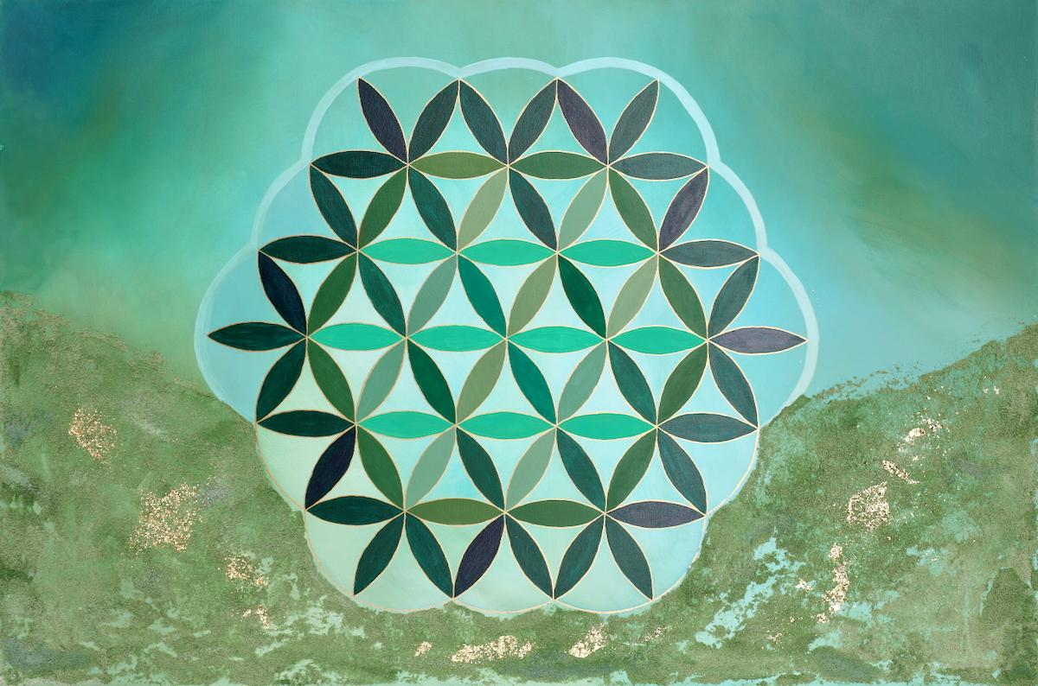
ALEXIS VERDUGO
“Dreamseed”

Slide 2
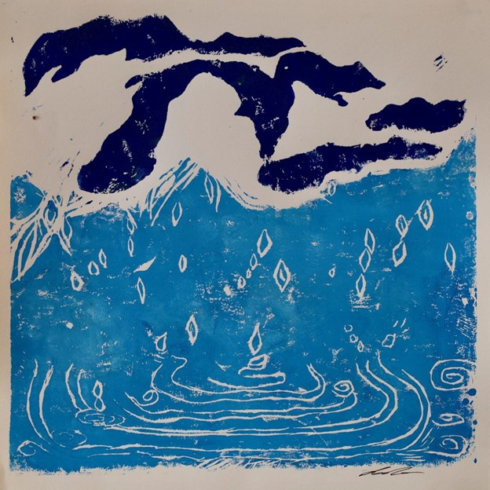
AMY FORD
“Water”

Slide 3
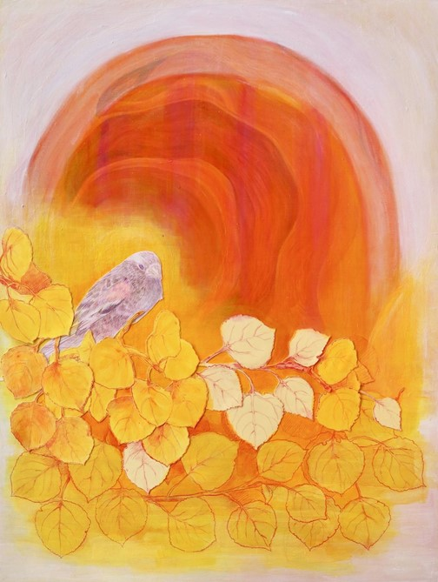
ANA BARANDA
“How Does It Feel To Be So Small”

Slide 4
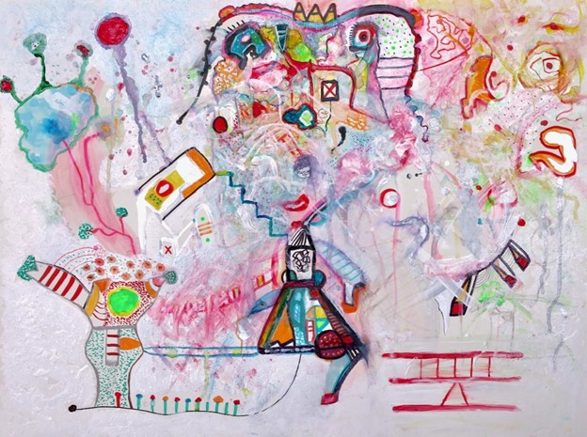
ANAGAMIN
“Regulate Yourself”

Slide 5
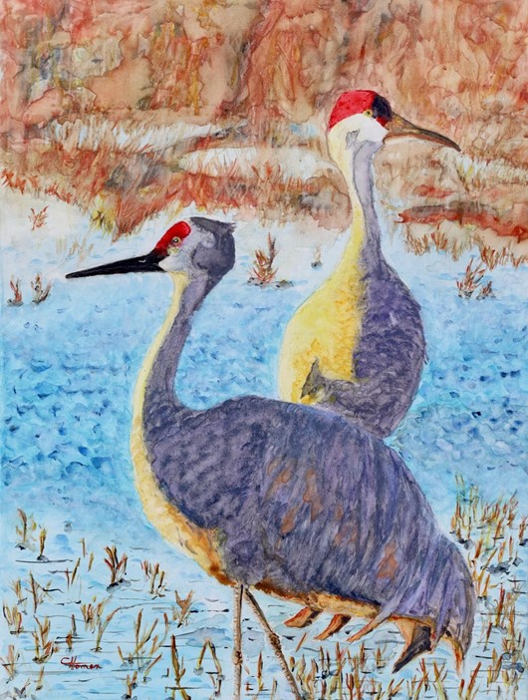
CHRIS HORMAN
“Sandhill Sunset”

Slide 6
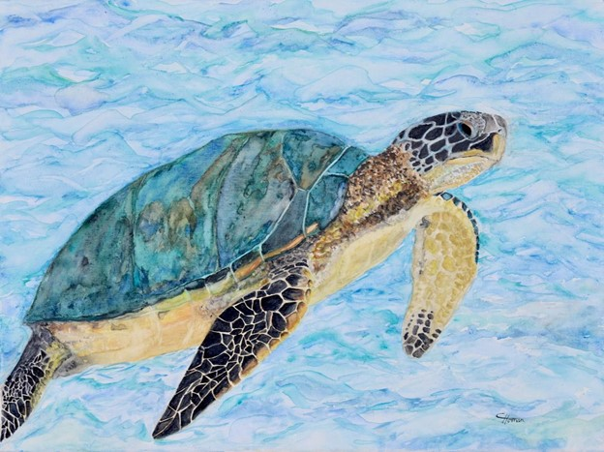
CHRIS HORMAN
“Sea Serenity”

Slide 7
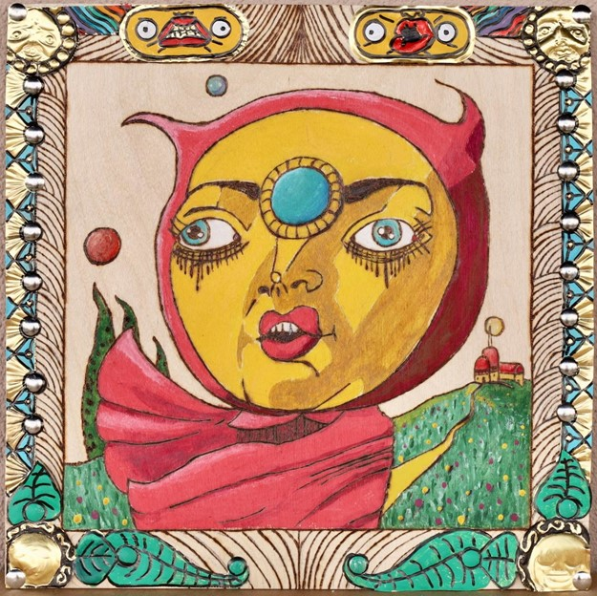
DREW LAUDERDALE
“The Devil You Left at the Crossroads”

Slide 8
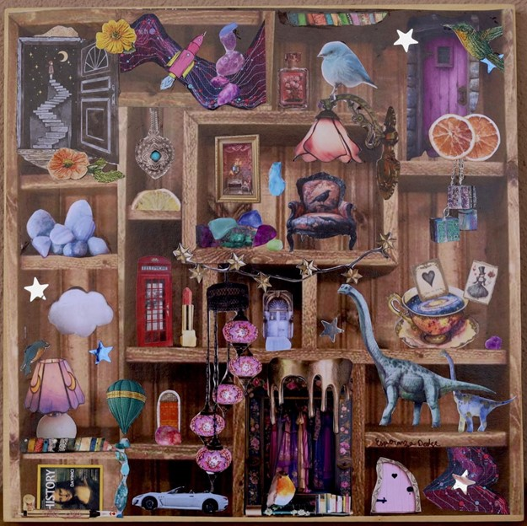
ESPERANZA DODGE
“Enchanted Nook”

Slide 9
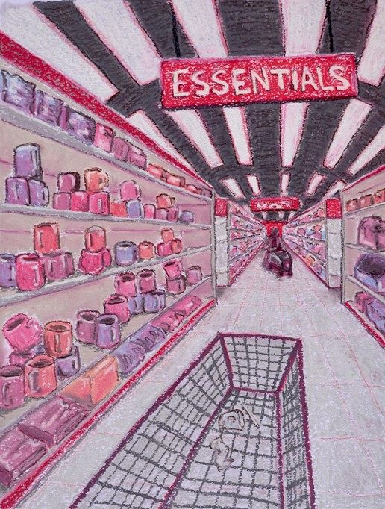
EVE TALLULA GOTTWALD
“We Can’t Live Without This”

Slide 10
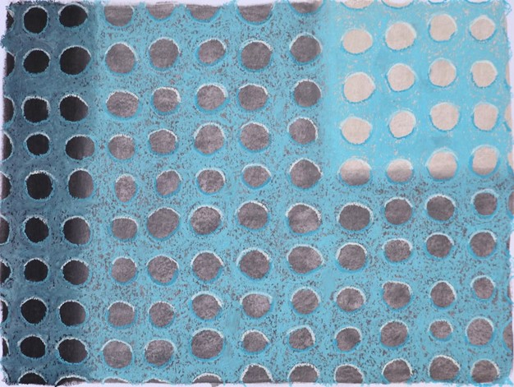
EVE TALLULA GOTTWALD
“Bus Stop”

Slide 11
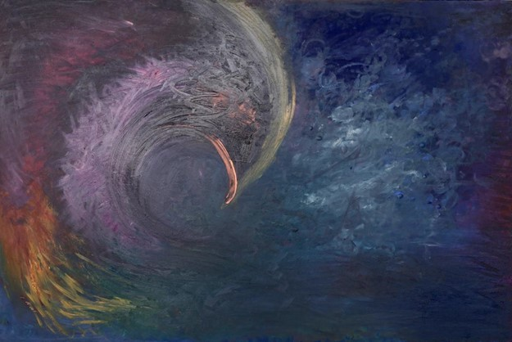
GENEVIEVE BUSKIRK
“La Llorona’s Grief”

Slide 12
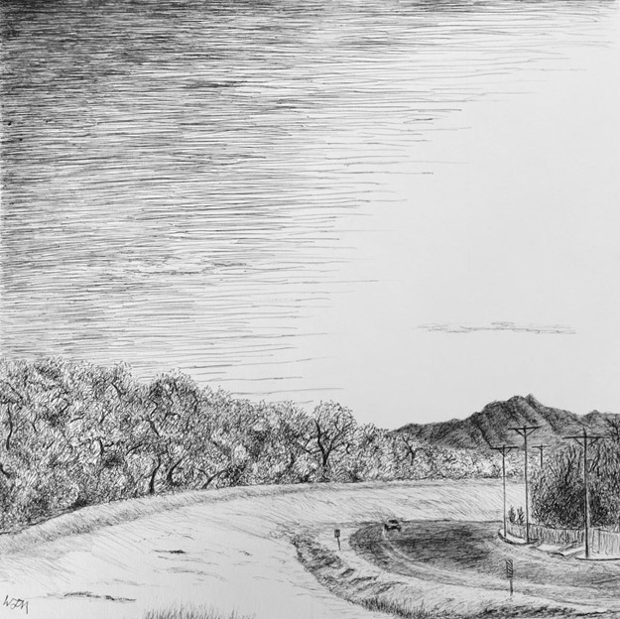
JASON MCINNES
“Arcs”

Slide 13
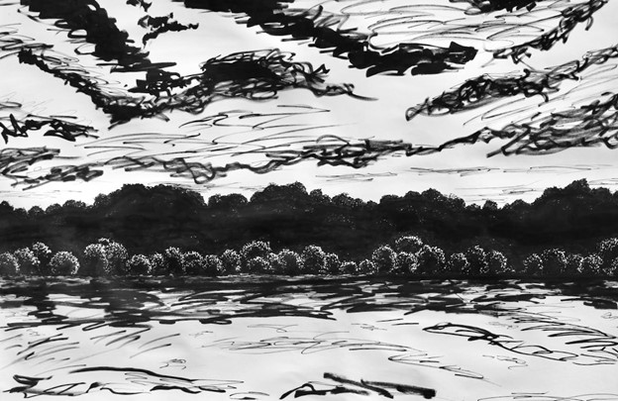
JASON MCINNES
“Riverbank”

Slide 14
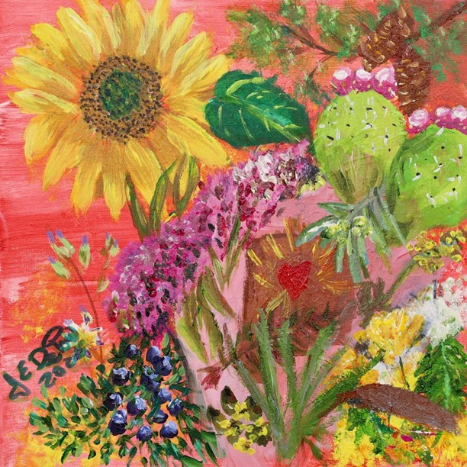
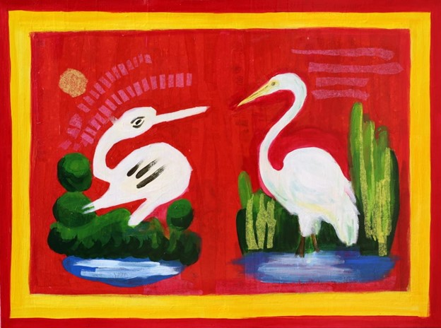
JOYCE DEPOW
“Eating Albuquerque”

Slide 15
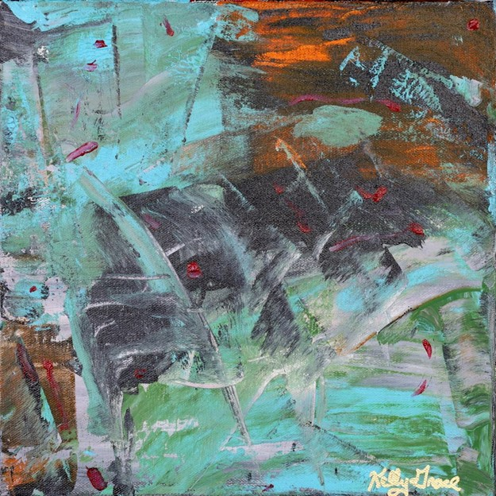
KELLY SOPHIA GRACE
“Catalyst for Revolution”

Slide 16
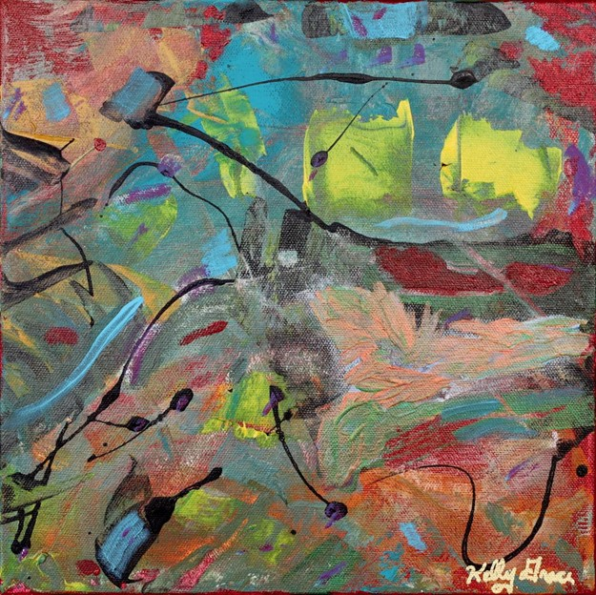
KELLY SOPHIA GRACE
“When the Veil was Lifted”

Slide 17
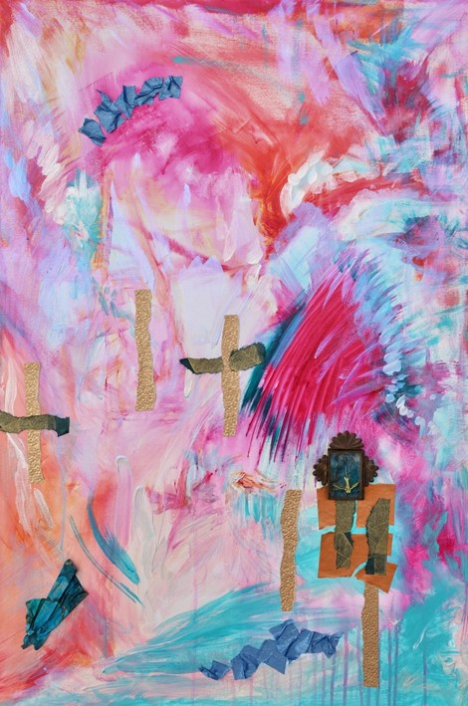
NATALIE OLSON
“Where Do I Start Again?”

Slide 18
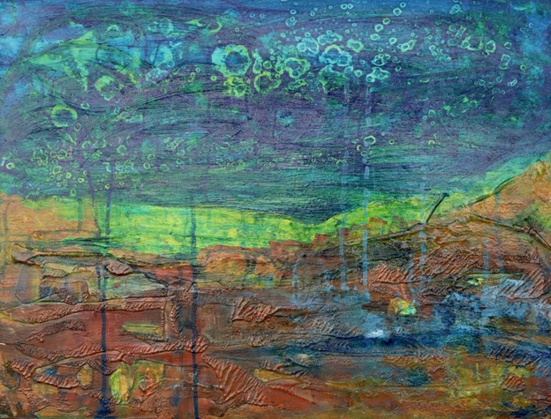
NIKKI JOSEPH
“In the Beginning”

Slide 19
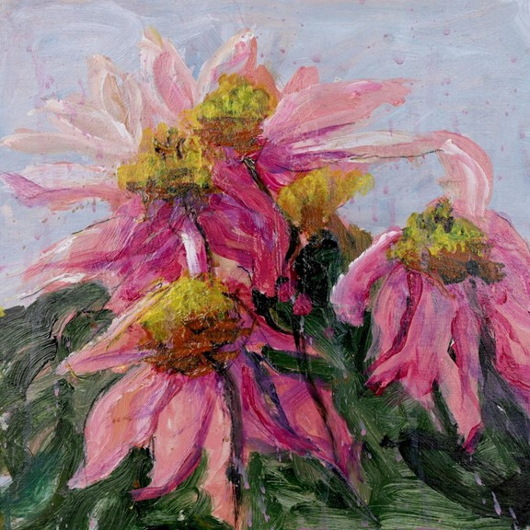
NIKKI JOSEPH
“Pink Flow of Life”

Slide 20
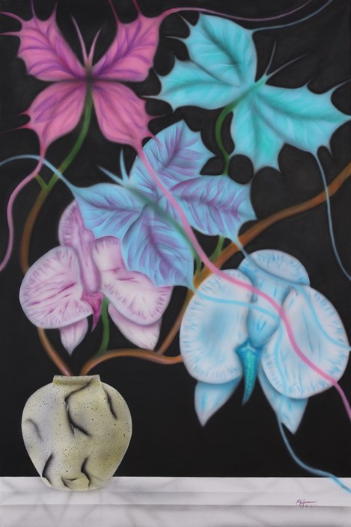
ORLANDO HERRERA
“Family Tree”

Slide 21
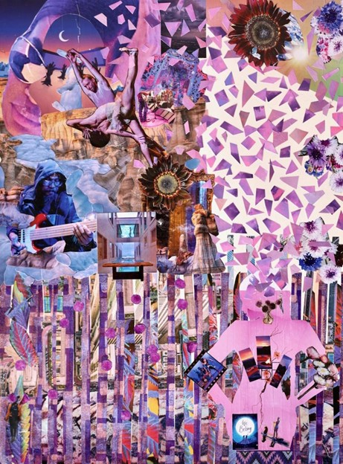
SHILOH BURTON
“Devine Delight”

Slide 22
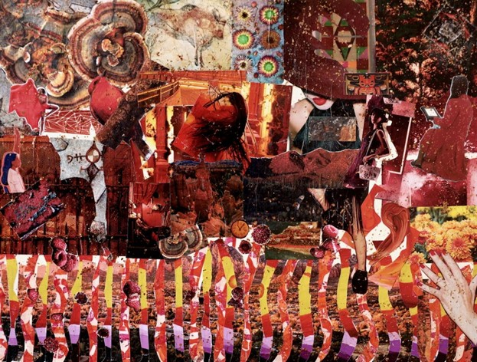
SHILOH BURTON
“Flame”

Slide 23
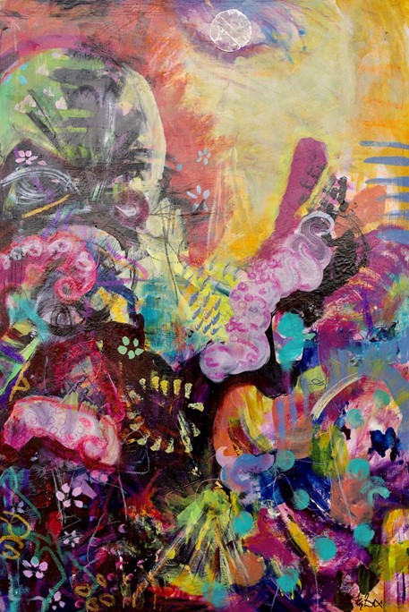
TRACEY BACA
“From Shadow’s Embrace”

Slide 24
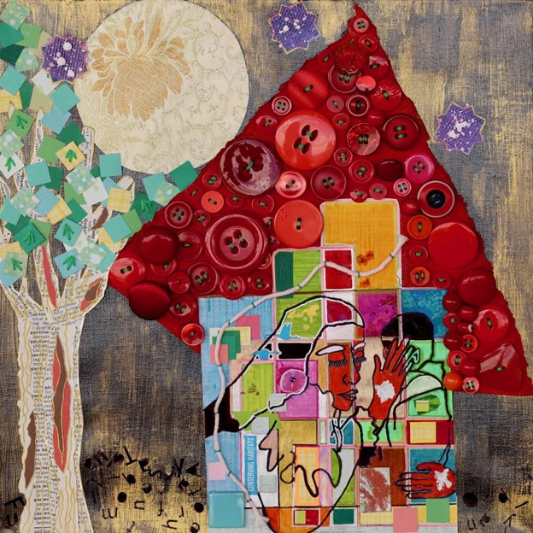
W. L. LEE
“Goodnight Moon”

